Slide 1
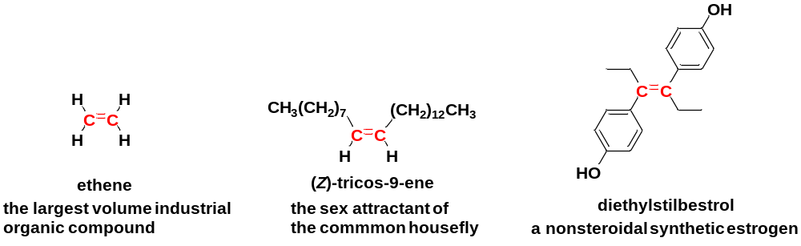
Chapter 4 Alkenes and Alkynes
4-1 Introduction
Alkenes are hydrocarbons with carbon-carbon double bonds. The C=C bond is the functional group of an alkene.
Alkenes are sometimes called olefins.
Alkenes are among the most important industrial compounds, and many alkenes are also found in plants and animals.

Slide 2
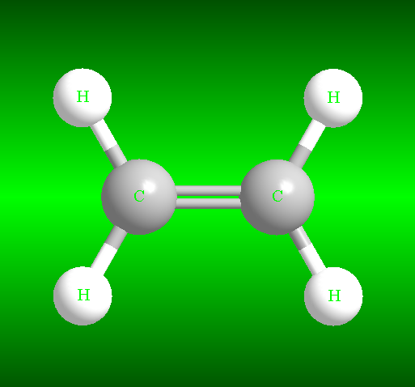
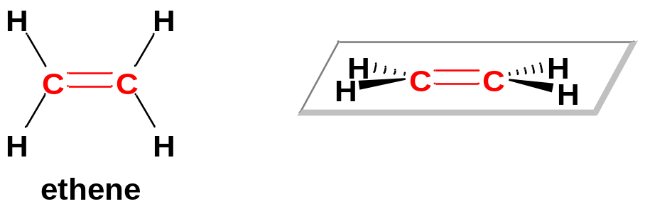
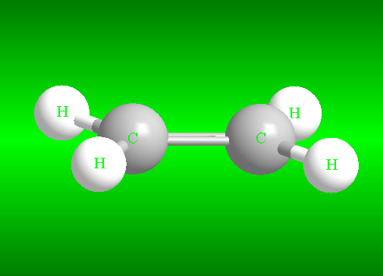
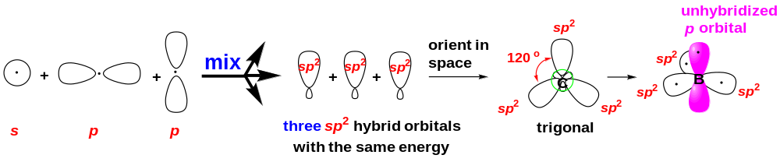
4-2 Structure of the Alkene Double Bond
Ethene has a planar structure, with bond angles around 120°.
The explanation of hybridization theory: Each carbon atom of ethene adopts the sp² hybridization.
Element | Electronic configuration | Valence Electrons
H | 1s¹ | 1
C | 1s²2s²2p_{x}¹2p_{y}¹2p_{z}⁰ | 4

Slide 3
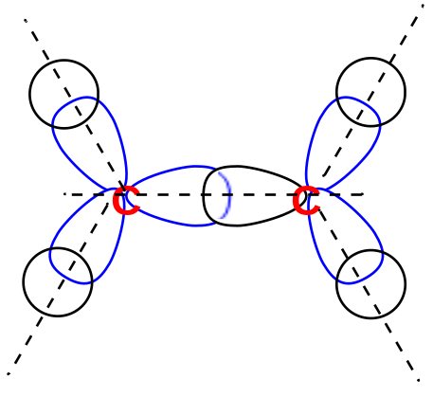
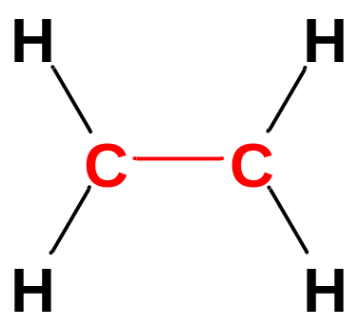
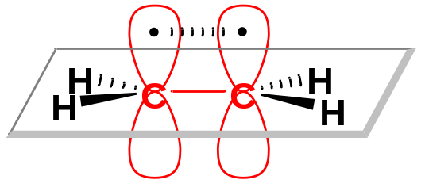
The σ framework of ethene:
The C-C sigma bond of the double bond is formed by sp²-sp² overlap. The C-H sigma bonds are sp²-s overlap.
The bond angles are around 120º.
p-p overlap
The formation of the π bond:
Each sp²-hybrid carbon atom still has an unhybridized p orbital. The two electrons in these orbitals form the second bond between the double-bonded carbon atoms.
For pi overlap to occur, these p orbitals must be parallel, which requires that the two carbon atoms be oriented with all their C-H bonds in a single plane.
Half of the pi-bonding orbital is above the C-C sigma bond, and the other half is below the sigma bond.

Slide 4
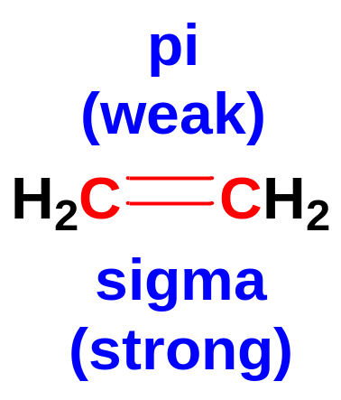
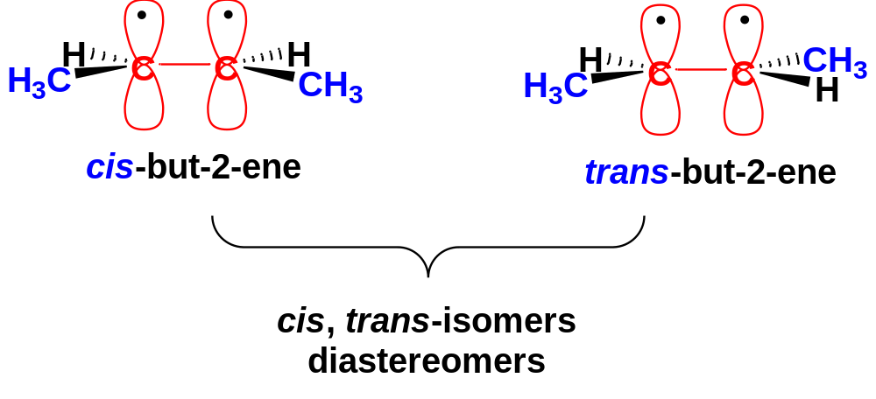
The C-C sigma bond is a good sp²-sp² overlap in a head-to-head manner. C-C sigma bond is strong.
The C-C pi bond is a relatively poor p-p overlap in a side-by-side manner. C-C pi bond is relatively weak.
Unlike single bonds, a carbon-carbon double bond does not permit rotation. This is the origin of cis-trans isomerism in alkenes.
If two groups are on the same side of a double bond (cis-isomer), they cannot rotate to opposite sides (trans-isomer) without breaking the pi bond.
cis- and trans-isomers are two distinct isomers, which belong to diastereomers.

Slide 5
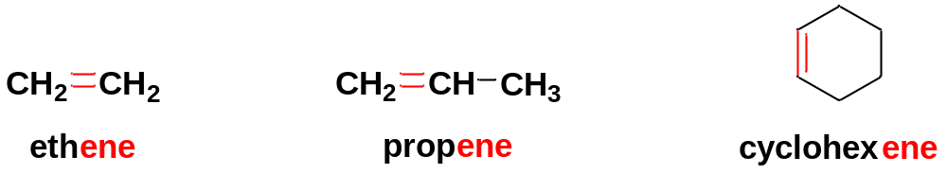
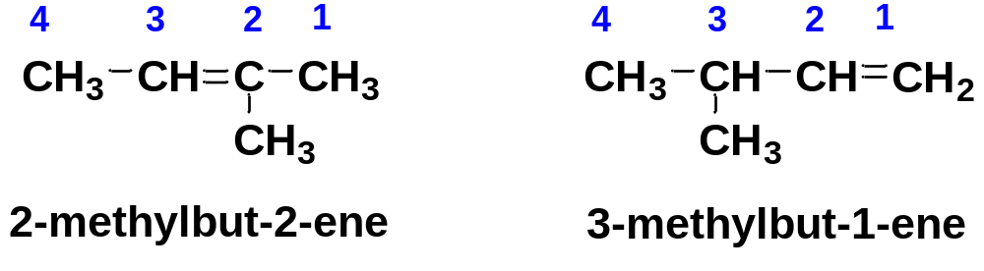
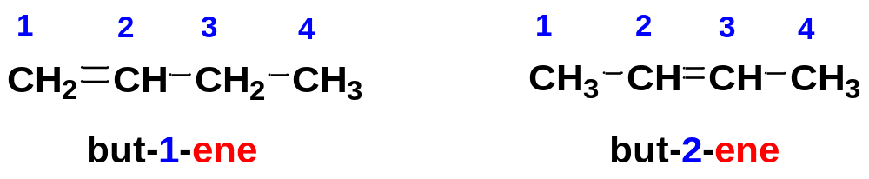
4-3 Nomenclature
4-3-1 IUPAC and Common Names of Alkenes
Simple alkenes are named much like alkanes, using the root name of the longest carbon chain. If the main chain contains the double bond, the ending is changed from –ane to –ene.
When the chain contains more than three carbon atoms, a number is used to give the location of the double bond.
The chain is numbered starting from the end closest to the double bond, and the double bond is given the lower number of its two double-bonded carbon atoms.
In the case of substituted alkenes, each alkyl group attached to the main chain is listed with a number to give its location. The double bond is still given preference in numbering.

Slide 6
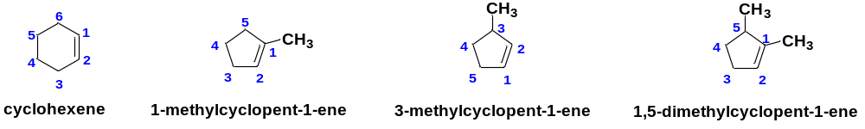
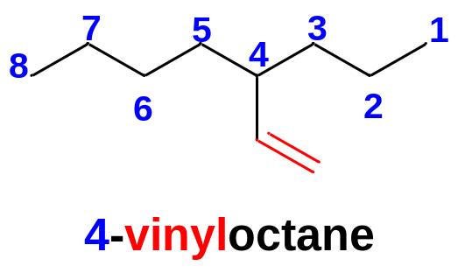
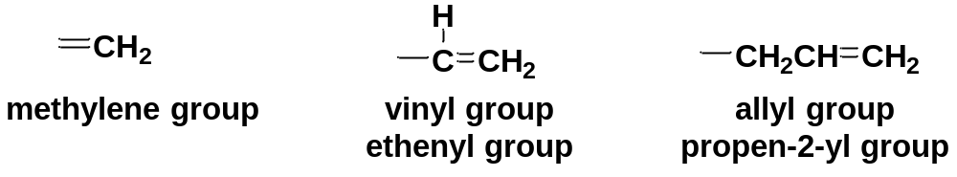
Cycloalkenes are assumed to have the double bond in the number 1 position.
If the C=C bond is not a part of the longest carbon chain, it is treated as a substituent in nomenclature.
C=C bonds named as substituents are called alkenyl groups:

Slide 7
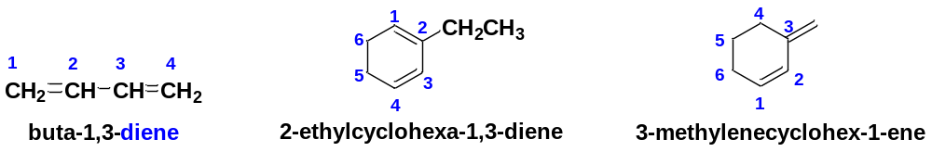
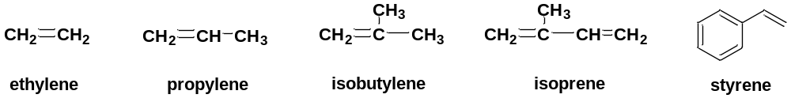
A compound with two double bonds is a diene. Numbers are used to specify the locations of the double bonds.
Common names are sometimes used for the simplest alkenes.

Slide 8
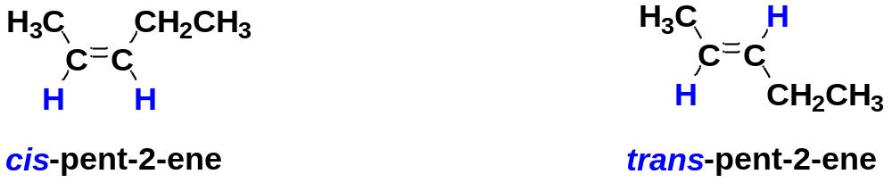
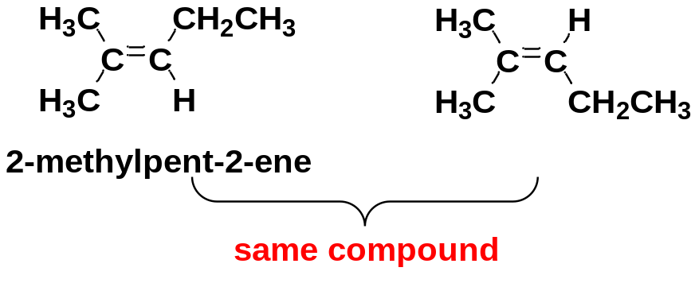
4-3-2 Cis-Trans Nomenclature
The rigidity and lack of rotation of C=C bonds give rise to cis-trans isomerism.
To have possible cis-trans isomers, the alkenes must have each double bonded carbon bonded to two different groups.
If two similar groups bonded to the carbons of the double bond are on the same side of the bond, the alkene is the cis isomer.
If two similar groups bonded to the carbons of the double bond are on the opposite sides of the bond, the alkene is the trans isomer.
different
different
same

Slide 9
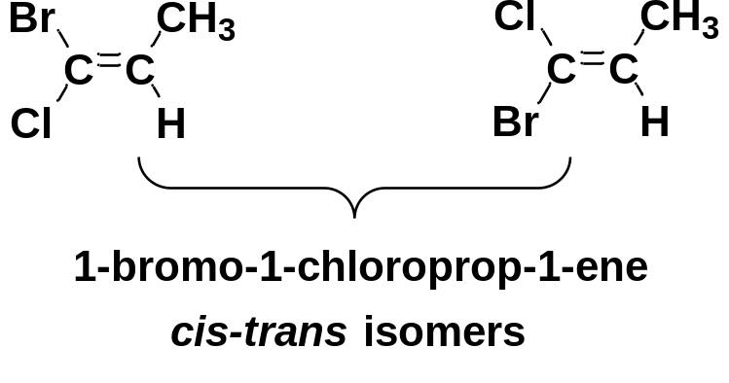
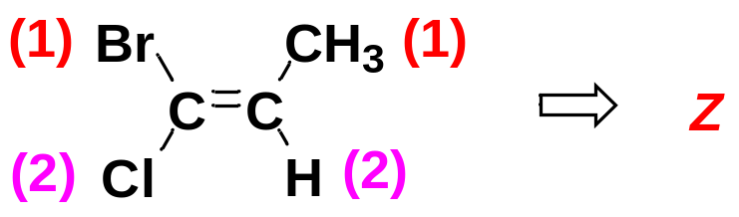
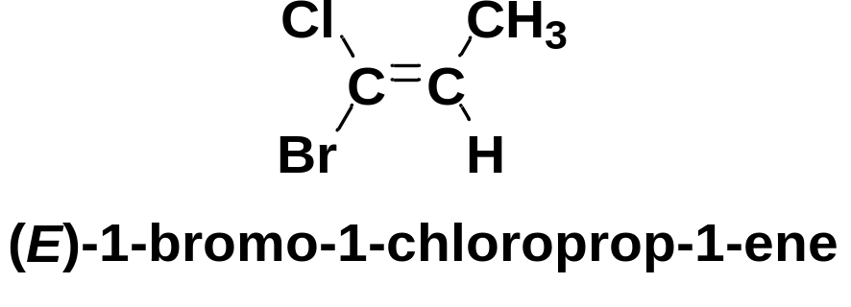

4-3-3 E-Z Nomenclature
The cis-trans nomenclature sometimes fails to give an unambiguous name.
To deal with this problem, we use the E-Z system of nomenclature for cis-trans isomers.
To name an alkene by the E-Z system:
Mentally separate the double bond into its two ends.
Use the CIP rules to assign first and second priorities to the two substituents on each end.
If the two first-priority groups are together on the same side of the double bond, we have the Z isomer.
If the two first-priority groups are on opposite sides of the double bond, we have the E isomer.

Slide 10
4-4 Physical Properties of Alkenes
Like alkanes, alkenes are relatively nonpolar.
Most physical properties of alkenes are similar to those of the corresponding alkanes.
Solubility: They are insoluble in water but soluble in nonpolar solvents such as hexane, gasoline, halogenated solvents, and ethers.
Boiling points: increase smoothly with molecular weight; increased branching leads to lower boiling points.
Densities: around 0.6-0.7 g/cm³.

Slide 11
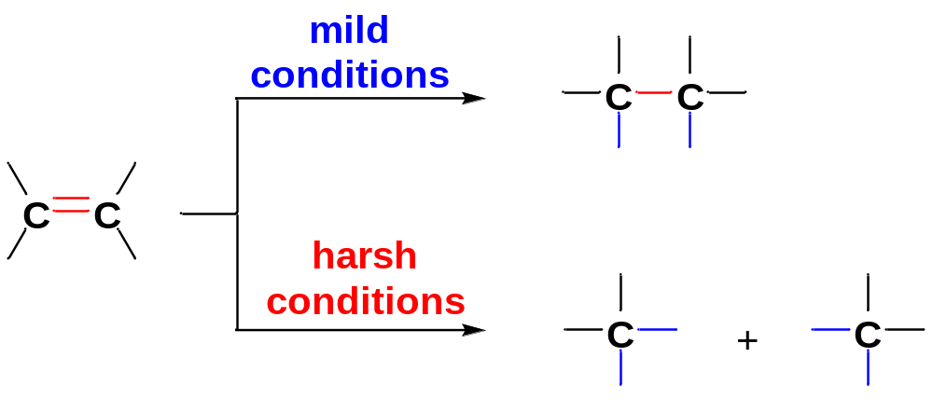
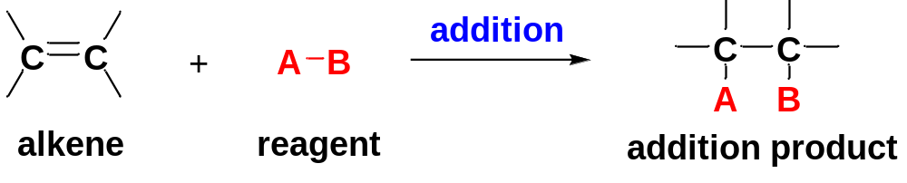
4-5 Reactivity of the C=C bond
The reactions of alkenes arise from the reactivity of the carbon-carbon double bond C=C.
A C=C double bond consists of a strong sigma bond and a relatively weak pi bond.
Under mild conditions, the relatively weak pi bond breaks to give new products, the strong sigma bond remains.
Under harsh conditions, both the sigma bond and the pi bond break, the alkene is cleaved into smaller molecules.
Addition reaction is the most common reaction of alkenes.

Slide 12
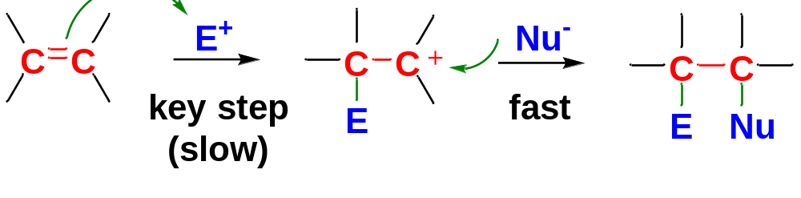
4-5-1 Electrophilic Addition to Alkenes
1> Electrophiles and Nucleophiles
Electrophiles | Lewis Acids | Species that can accept electron pairs to form new bonds | H⁺, AlCl₃, etc.
Nucleophiles | Lewis Bases | Species with nonbonding electrons or weakly held bonding electrons that can be donated to form new bonds | C=C, HO⁻, etc.
2> Electrophilic Addition
The alkene as a nucleophile combines with a strong electrophile to form one product molecule.
A carbocation has a carbon atom with only 3 bonds and a positive charge. Carbocations are highly reactive organic intermediates.
Step 1: A strong electrophile attacks the pi bond to form a carbocation (rate-limiting step, key step).
Step 2: The carbocation (as a strong electrophile) reacts with a nucleophile (often a weak one) to form the addition product (fast).
By varying the species of strong electrophiles, a wide variety of electrophilic addition products can be formed with alkenes.

Slide 13
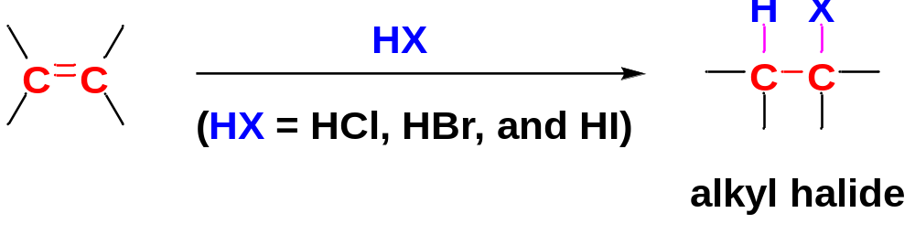
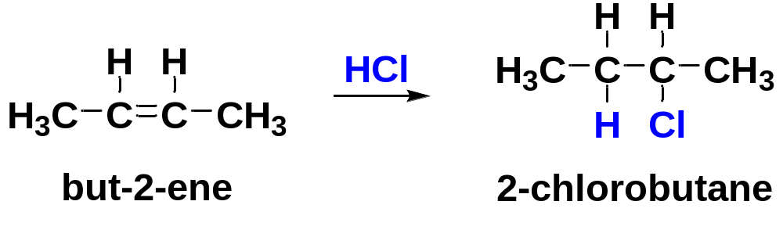
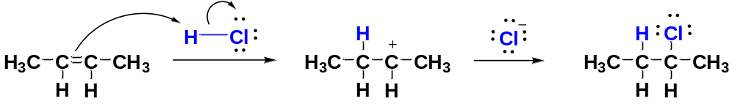
4-5-2 Addition of Hydrogen Halides to Alkenes to form Alkyl Halides
General Pattern
Example
Mechanism

Slide 14
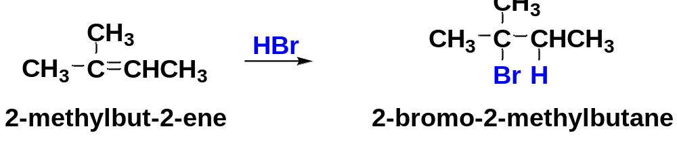
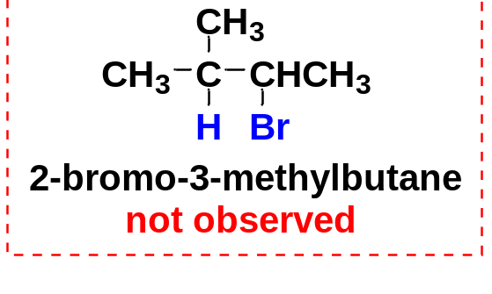
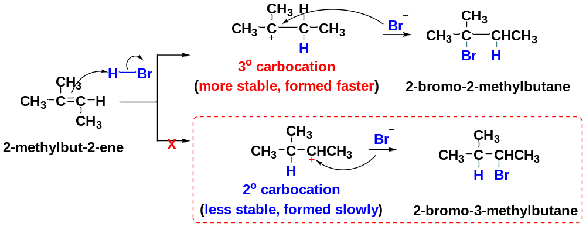
Regioselectivity and Markovnikov’s rule
The addition of HBr to 2-methylbut-2-ene could lead to two products in principle, yet only one is observed.
The addition of HBr (and other HX) is said to be regioselective because in each case, one of the two possible orientations of addition results preferentially over the other.
Markovnikov’s rule: In an electrophilic addition to an alkene, the proton adds to the end of the double bond that is less substituted to give the more substituted carbocation (the more stable carbocation).

Slide 15
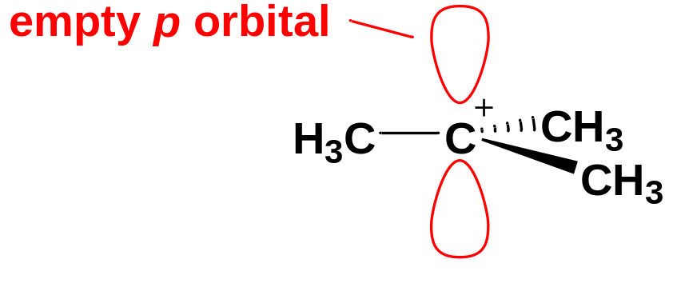
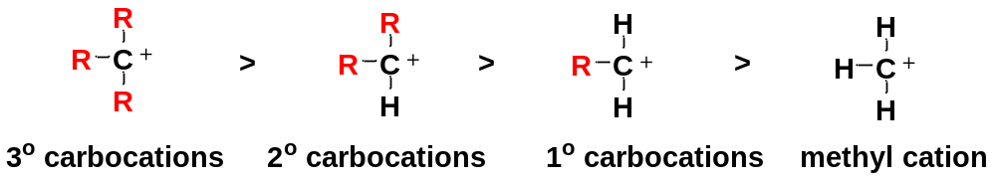
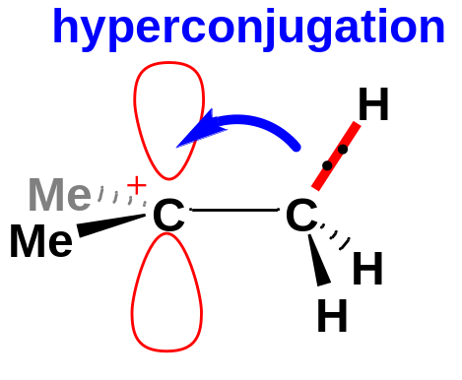
The structure of carbocations and their relative stabilities
Carbocations have planar or nearly planar structures.
In a carbocation, the positively charged carbon is an sp² hybrid carbon.
Relative stability of carbocations:
Alkyl groups are electron-donating groups (EDG)

Slide 16
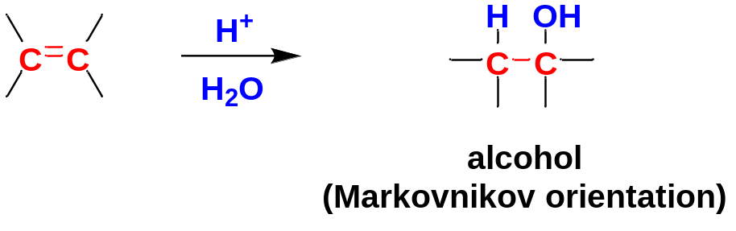
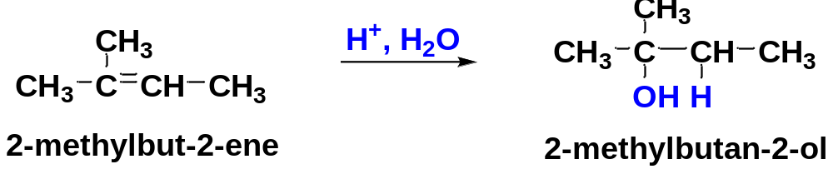
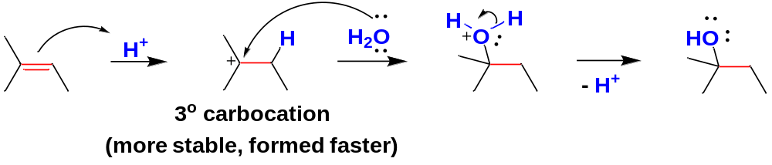
4-5-3 Addition of Acidic Water to Alkenes to form Alcohols
An alkene may react with water in the presence of a strongly acidic catalyst to form an alcohol.
Formally, this reaction is a hydration (the addition of water), with a hydrogen atom adding to one carbon and a hydroxyl group adding to the other.
Like the addition of HX, hydration is regioselective: it follows Markovnikov’s rule, giving a product in which the new hydrogen has added to the less substituted end of the double bond.
mechanism
protonation
nucleophilic attack
deprotonation

Slide 17
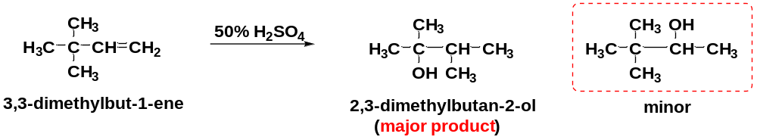
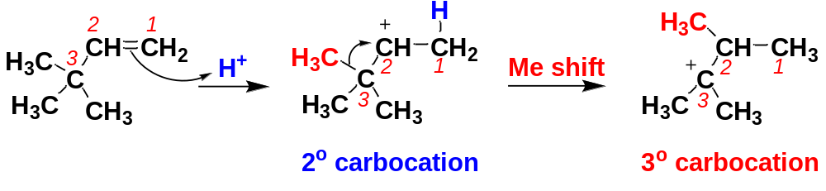
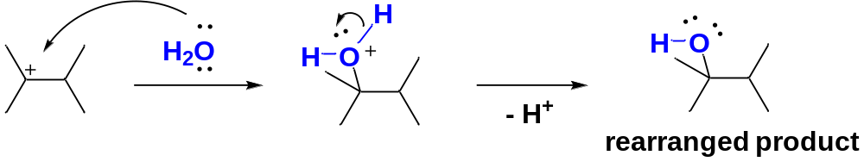
Like other reactions that involve carbocation intermediates, hydration may take place with rearrangement.
mechanism
The driving force of carbocation rearrangement: formation of a more stable carbocation.
The shifting group can be an alkyl group or a H.

Slide 18
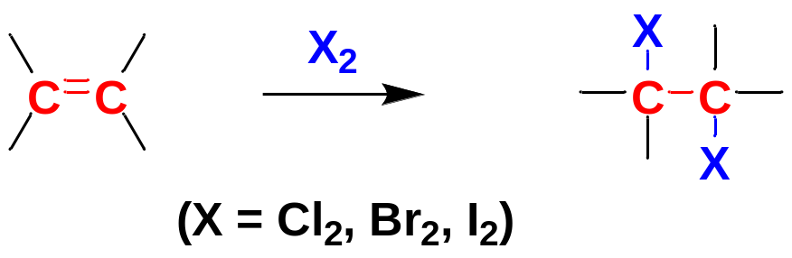
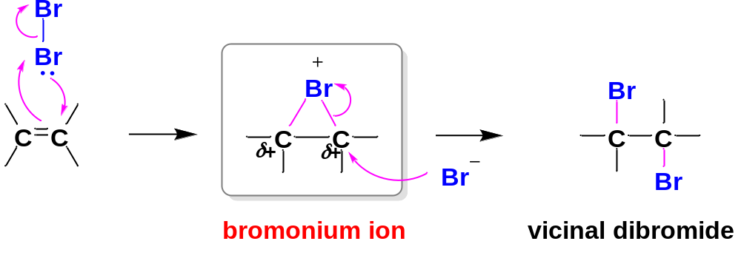
4-5-4 Addition of Halogens to Alkenes to form Vicinal Dihalides
In this reaction, the halogen molecule is the electrophile.
Cl₂, Br₂ and I₂ commonly add to alkenes by such a halonium ion mechanism.
1> Pattern
2> Mechanism
Step 1
Step 2
A bromonium ion contains a three-membered ring with a positive charge on the bromine atom.
Unlike a normal carbocation, all the atoms in a bromonium ion have filled octets, resulting in greater stability.
However, the three-membered ring has considerable ring strain, which combined with a positive charge on the electronegative bromine atom, makes the bromonium ion–bearing carbon atoms strongly electrophilic.
Step 1: The pi electrons of an alkene (nucleophile) attack the bromine molecule (electrophile) , expelling bromide ion (leaving group) to give a bromonium ion (reactive intermediate).
Step 2: The electrophilic carbons of the bromonium ion are attacked by bromide (nucleophile) to open the bromonium ion and give a stable product.

Slide 19
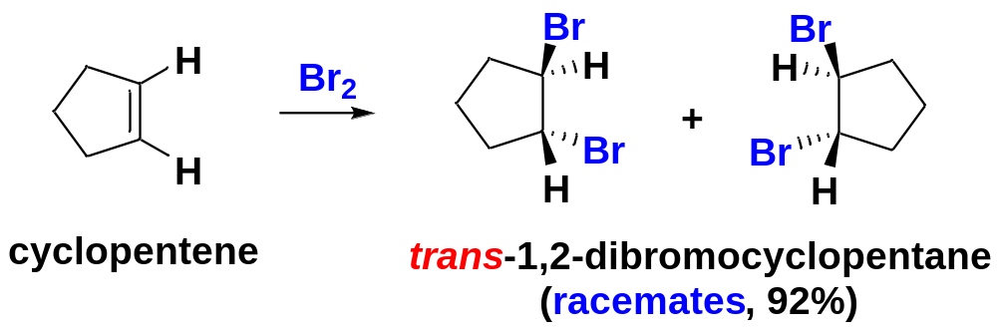
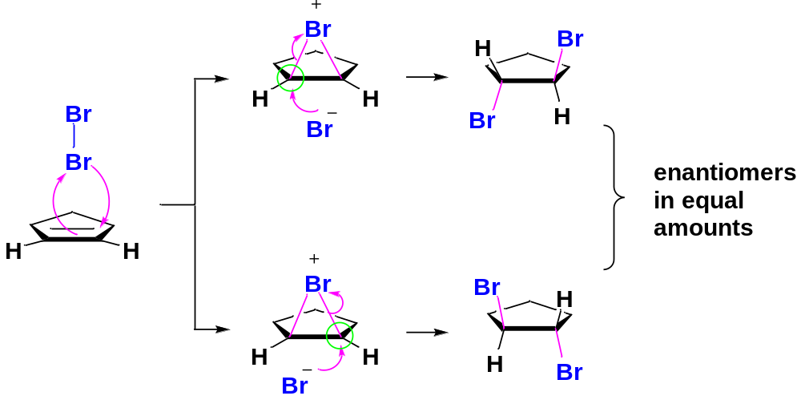
3> Stereochemistry of Halogen Addition: anti addition
The addition of bromine to an alkene is an anti addition.
Anti stereochemistry results from the bromonium ion mechanism.
The nucleophile (Br⁻) attacks the bromonium ion from the back side, in a manner similar to the S_{N}2 displacement.
This back-side attack assures anti addition.
backside attack in equal odds

Slide 20
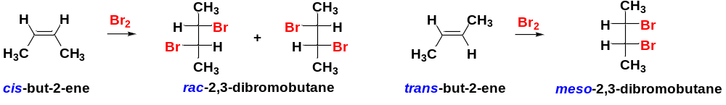
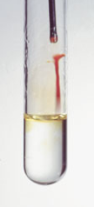
Additional examples of the anti addition of halogens to alkene:
4> Bromination as a Simple Chemical Test for C=C bonds
A solution of bromine in CCl₄ is a clear, deep red color.
The addition product dihalide is colorless.
The addition of bromine has been used as a simple test for the presence of C=C bonds: when the red solution of Br₂ is added to an alkene, the red bromine color quickly disappears because bromine adds across the C=C double bond.
An colorless alkene

Slide 21
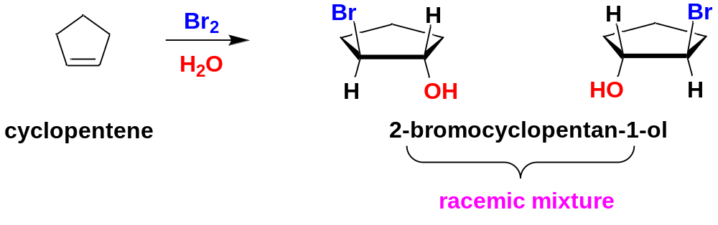
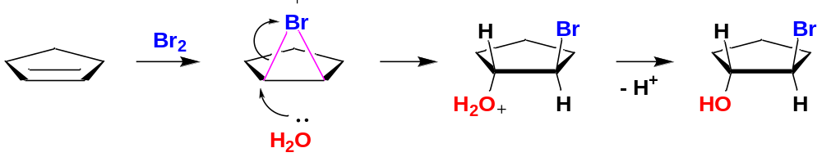
4-5-5 Addition of Halogens/H₂O to Alkenes to form Halohydrins
A halohydrin is an alcohol with a halogen on the adjacent carbon.
In the presence of H₂O, halogens add to alkenes to form halohydrins.
δ+
δ+
H₂O (exists in a large amount) as a nucleophile attacks from the back side
Stereochemistry of halohydrin formation: anti addition

Slide 22
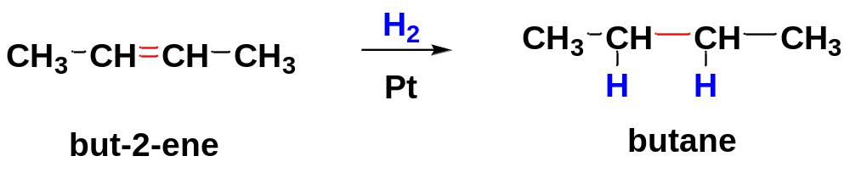

4-6 Reduction Reaction: Catalytic Hydrogenation of Alkenes to form Alkanes
Hydrogenation of an alkene is formally a reduction, with H₂ adding across the double bond to give an alkane. Alkenes are said to be unsaturated because they are capable of adding hydrogen in the presence of a catalyst to produce alkanes.
The process usually requires a catalyst containing Pt (platinum), Pd (palladium) or Ni (nickel), which is used to weaken the H-H bond.
Hydrogenation actually takes place at the surface of the metal catalyst, where the liquid solution (alcohol, acetic acid) of the alkene comes into contact with H₂ and the catalyst.
Because the two hydrogen atoms add from a solid surface, they add with syn stereochemistry.

Slide 23


4-7 Oxidation Reaction
4-7-1 Epoxidation of Alkenes to form epoxides
Some of the most important reactions of alkenes involve oxidation. When we speak of oxidation in organic chemistry, we usually mean reactions that form C-O bonds.
Oxidations are particularly important because many common functional groups contain oxygen, and alkene oxidations (epoxidation, hydroxylation, and oxidative cleavage) are some of the best methods for introducing oxygen into organic molecules.
In epoxidation, an alkene is converted to an epoxide by a peroxyacid.
A peroxyacid is a carboxylic acid that has an extra oxygen atom in a −O−O− (peroxy) linkage
Peroxyacetic acid and m-chloroperoxybenzoic acid (MCPBA) are common epoxidizing reagents.

Slide 24

The epoxidation is a concerted electrophilic addition where several bonds are broken and several are formed at the same time. Because the epoxidation takes place in one step, there is no opportunity for the alkene molecule to rotate and change its cis or trans geometry, therefore it retains whatever stereochemistry is present in the alkene.

Slide 25



4-7-2 Syn Hydroxylation of Alkenes to form Glycols
Converting an alkene to a glycol requires adding a hydroxyl group to each end of the double bond. This addition is called hydroxylation of the double bond.
The product is a vicinal diol, also called a glycol.
The two most common reagents for this purpose are osmium tetroxide and potassium permanganate.
Hydroxylation of alkenes is a syn addition.

Slide 26




4-7-3 Oxidative Cleavage of Alkenes
1> Cleavage by Permanganate
In a KMnO₄ hydroxylation, if the solution is warm or acidic or too concentrated, oxidative cleavage of the alkene may occur, in which the C=C double bond breaks.
The products of oxidative cleavage by KMnO₄ are mixtures of ketones and carboxylic acids.
A terminal =CH₂ group is oxidized to CO₂ and H₂O

Slide 27


2> Ozonolysis
Like warm, concd. KMnO₄ soludtion, ozone cleaves double bonds. However, ozonolysis is milder, and both ketones and aldehydes can be recovered without further oxidation.

Slide 28


4-8 Alkynes: Introduction
Alkynes are hydrocarbons that contain carbon-carbon triple bonds.
C≡C bond is the functional group of an alkyne.
A triple bond makes an alkyne two fewer hydrogens than corresponding alkene, four fewer hydrogens than corresponding alkane.
The molecular formula of alkynes: C_{n}H_{2n-2}.
The C≡C bonds are not common in drugs.

Slide 29

4-9 Nomenclature of Alkynes
1> Common Names:
View the alkynes as derivatives of acetylene.

Slide 30




2> IUPAC Names: similar to that for alkenes.
(1) Alkynes and Diynes:
Find the longest continuous chain of carbon atoms as the main chain.
Change the -ane ending of the parent alkane to -yne.
Number the main chain from the end closest to the triple bond. The position of the triple bond is designated by its lower-numbered carbon atom.
Substituents are given numbers to indicate their locations.

Slide 31


Sometimes, the part containing the C≡C is regarded as a group: alkynyl group
1
2
3
4
(2) Alkenynes:
compounds simultaneously contain a triple bond and a double bond.
Choose the longest continuous chain as the main chain.
Number the main chain from the end closest to an unsaturated bond (a double bond or a triple bond).
In case of a tie, the numbering begins at the end closer to the double bond, which is given higher priority than the triple bond.

Slide 32



4-10 Electronic Structure of Alkynes
Acetylene has a linear structure.
The two triple bond carbon atoms adopt sp hybridization.
The C−C sigma bond of the triple bond is sp-sp overlap.
pi bond
sigma bond
pi bond
The two pi bonds are two p-p overlap.
The two pairs of unhybridized p orbitals overlap at 90°.
1 Triple bond = 1 σ + 2 π

Slide 33
4-11 Physical Properties of Alkynes
Alkynes are relatively nonpolar molecules. The physical properties of alkynes are similar to those of alkanes and alkenes of similar molecular weights.
Solubility: nearly insoluble in water; quite soluble in most organic solvents.
Boiling points: nearly the same as those of alkanes and alkenes with similar carbon skeletons.
Density: less dense than water, 0.6-0.8 g/cm³.
Odors: many alkynes have characteristic, mildly offensive odors.

Slide 34


4-11 Acidity of Terminal Alkynes: formation of Alkynide Ions
An alkyne with the triple bond coming at the end of the carbon chain is called a terminal alkyne.
In a terminal alkyne, there is an acetylenic hydrogen (H−C≡C −).
An alkyne with the triple bond located somewhere other than the end of the carbon chain is called an internal alkyne. There is no acetylenic hydrogen in an internal alkyne.
Many of an alkyne’s chemical properties depend on whether it is a terminal alkyne.
acetylenic hydrogen
4-11-1 Acidity of Terminal Alkynes
Terminal akynes RC≡C−H are much more acidic than corresponding alkenes and alkanes.

Slide 35


The acidity of an acetylenic hydrogen stems from the nature of the sp hybridization of the carbon atom.
sp hybrid orbital: 1/2 s character
sp² hybrid orbital: 1/3 s character
sp³ hybrid orbital: 1/4 s character
An sp hybrid orbital has more s character than an sp² hybrid orbital and an sp³ hybrid orbital.
Electron in s orbital is closer, tightly held by the nucleus:
More s character of the orbital, closer the bonding electrons to the carbon atom.
The C-H is more polar, increasing the tendency of transferring the bonding electrons to the direction of carbon atom.
The acidity of a C−H bond increases with the increasing s character of the orbitals of the carbon atoms: sp > sp² > sp

Slide 36



4-11-2 Formation of Alkynide Ions
The presence of a very strong base helps remove the acidic acetylenic H, providing an alkynide ion.
Very strong base such as sodium amide (NaNH₂) is needed to deprotonate a terminal alkyne, because acetylenic H is only slightly acidic.
Alkynide ions are strong carbon nucleophiles which play a central role in alkyne chemistry.
Internal alkynes do not have acetylenic protons, so they do not react with NaNH₂.
(an internal alkyne, no acetylenic H)

Slide 37



4-11-3 Alkylation of Alkynide Ions：Synthesis of substituted alkynes
An alkynide ion is a strong carbon nucleophile. It can displace a halide ion from a methyl halide or an unhindered 1° RX to form a substituted alkyne.
By such a reaction, an alkyl group (Me, or 1°) is bonded to a triple bond carbon, forming a new and elongated alkyne.

Slide 38


4-12 Addition Reactions of Alkynes
Many of the reactions of alkynes are similar to the corresponding reactions of alkenes because both involve pi bonds between two carbon atoms.
(1σ, 1π)
(1σ, 2π)

Slide 39


4-12-1 Catalytic Hydrogenation to Produce Alkanes
In the presence of Pt, Pd, or Ni, hydrogen adds to an alkyne, reducing it to an alkane.
Catalytic hydrogenation takes place in two stages, with an alkene intermediate. With efficient catalysts such as Pt, Pd, or Ni, it is usually impossible to stop the reaction at the alkene stage.
However, hydrogenation of an alkyne can be stopped at the alkene stage by using a “poisoned” (partially deactivated) catalyst made by treating a good catalyst with a compound that makes the catalyst less effective.

Slide 40

Lindlar’s catalyst is a poisoned Pd catalyst, composed of powdered BaSO₄ (barium sulfate) coated with Pd, poisoned with quinoline.
Lindlar’s catalyst
Catalytic hydrogenation proceed with syn addition, two H atoms adding to the same side of the C≡C triple bond to produce the cis-alkene from an internal alkyne.

Slide 41



4-12-2 Addition of Halogens (Electrophilic Addition)
Bromine and chlorine add to alkynes just as they add to alkenes.
The stereochemistry of addition may be either syn or anti, often giving mixtures of cis and trans products.
If 2 mol of halogens add to an alkyne, a tetrahalide results.

Slide 42



4-12-3 Addition of HX (Electrophilic Addition)
Hydrogen halides add across the triple bond of an alkyne in much the same way they add across the alkene double bond.
When a hydrogen halide adds to a terminal alkyne, the product has the orientation predicted by Markovnikov’s rule.
When 2 mol of HX add to an alkyne, the second addition occurs usually with the same orientation as the first, leading to a geminal dihalide.
Proton adds to the less substituted carbon to form a vinyl cation with the positive charge on the more highly substituted carbon atom

Slide 43


4-12-4 Mercuric Ion-Catalyzed Hydration of Alkynes to Form Ketones and Aldehydes
Alkynes undergo acid-catalyzed addition of H₂O across the triple bond in the presence of mercuric ion as a catalyst.
The hydration of alkynes is similar to the hydration of alkenes, and it also goes with Markovnikov orientation.
The direct addition product is enols. However, enols tend to be unstable and isomerize to the ketone form. Enols formed by terminal alkynes isomerize to methyl ketones.
This isomerization involves the shift of a proton and a double bond. This type of rapid equilibrium is called the Keto-enol tautomerism.
Keto-enol tautomerism

Slide 44


(terminal alkyne) (methyl ketone)
(internal alkyne) (a mixture of two ketones)

Slide 45



4-12-5 Oxidation of Alkynes
1> Permanganate Oxidations
(1) Under mild conditions:

Slide 46



(2) Under warm or too basic conditions:
Internal alkynes are cleaved to give two carboxylic acids.
Terminal alkynes are cleaved to give a carboxylic acid and CO₂.

Slide 47


2> Ozonolysis
Ozonolysis of an alkyne, followed by hydrolysis, cleaves the triple bond to give two carboxylic acids.

